Slide 1

Creating efficiency with google Colab hour one Suzanna Howard West Jordan (UT) police department
*Gmail account required to use Google Colab

Slide 2

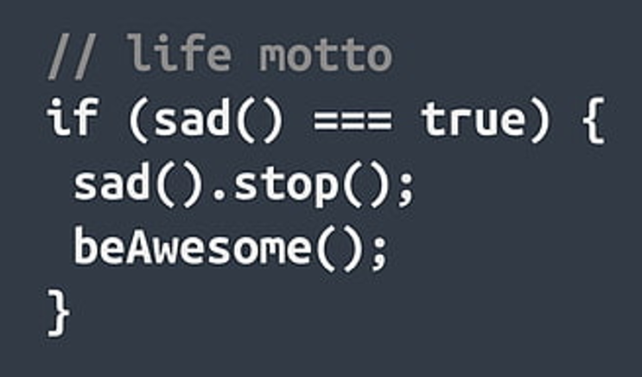

Slide 3
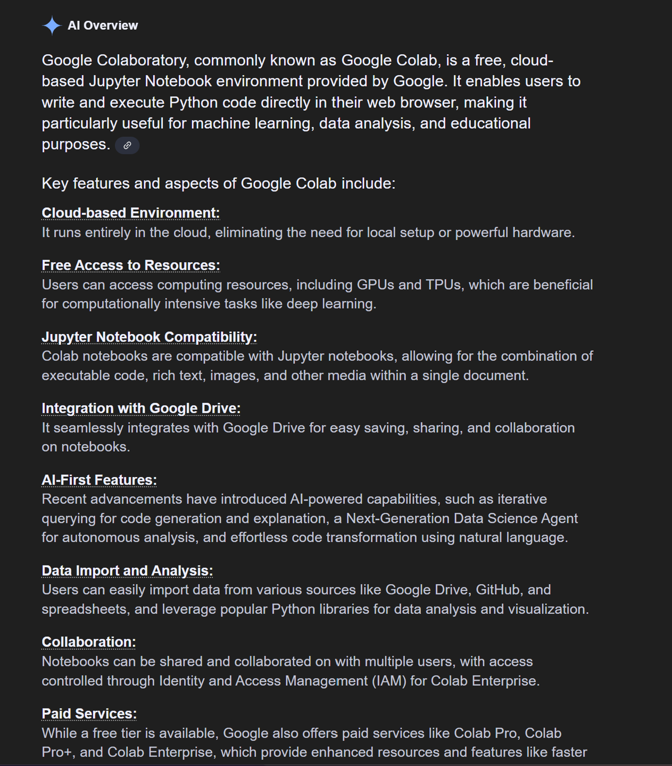
Use Google Colab online to build Jupyter Notebooks.
Drag and drop an Excel file into Google Colab
Use AI-generated Python code to write the steps we would do in Excel (sort, insert columns, formulas, clean data, etc)
Export files
Save/download Jupyter Notebook for future use
In Excel terms, it is similar to macros.

Slide 4

HOUR ONE
https://github.com/Suzanna-Howard34/IACA-Lab-Files
INTRODUCTION TO GOOGLE COLAB
CAVEATS
Activities:
dangerous intersections
graphs/charts
unpivot
HOUR TWO
INTRODUCTION TO GOOGLE COLAB
CAVEATS
Activities:
officer AVAILABILITY
forecasting / EDUCATED GUESSING
graphs/charts

Slide 5
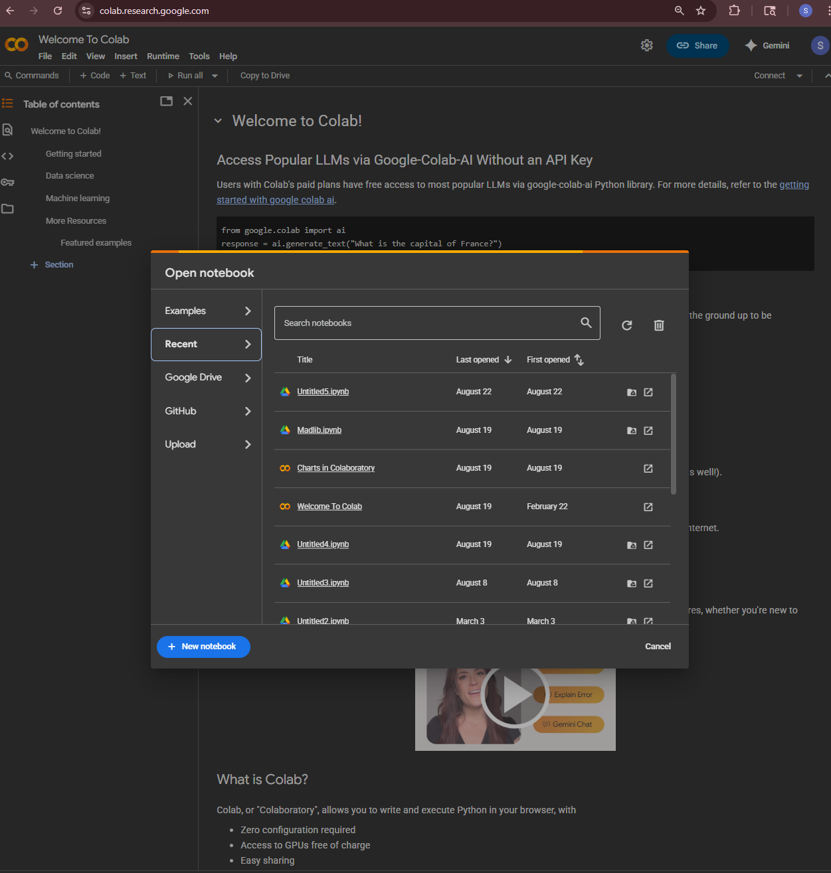
Google “Google Colab”
https://colab.research.google.com/
Type: Colab.new
GMAIL ACCOUNT REQUIRED
FREE ONLINE TOOL
NO INSTALLATION/CONFIGURATION
JUPYTER NOTEBOOKS
AI GENERATED PYTHON CODE
GEMINI
CHAT GPT
# COMMENT

Slide 6

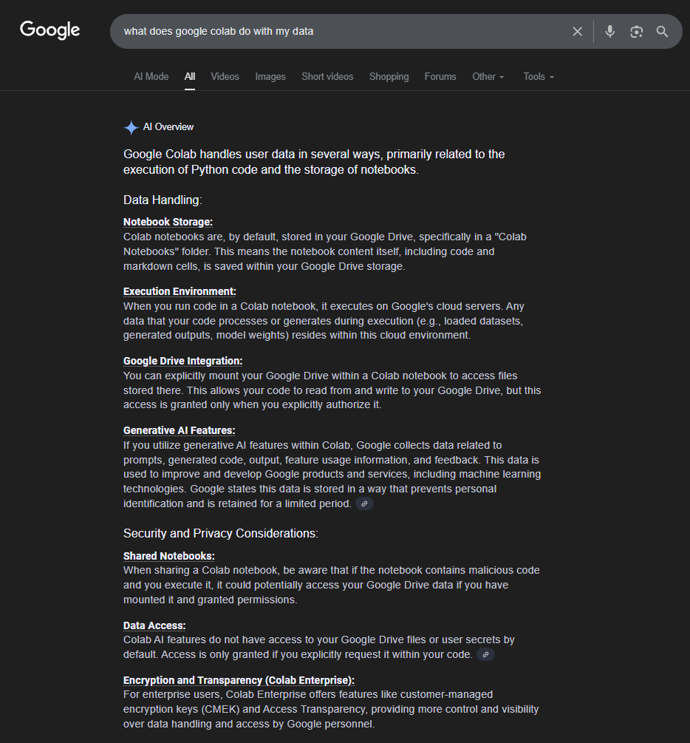

Slide 7
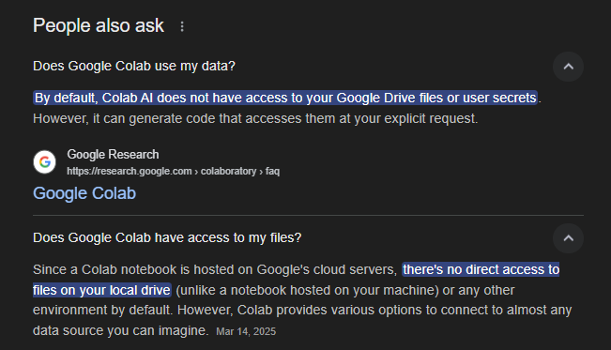
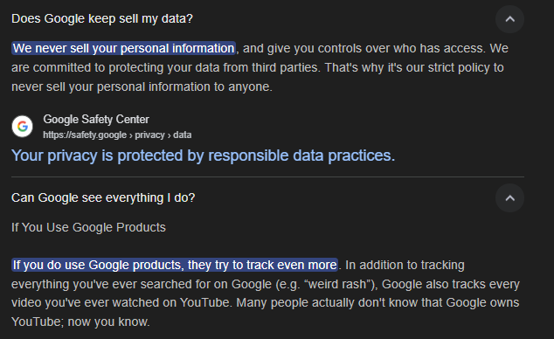

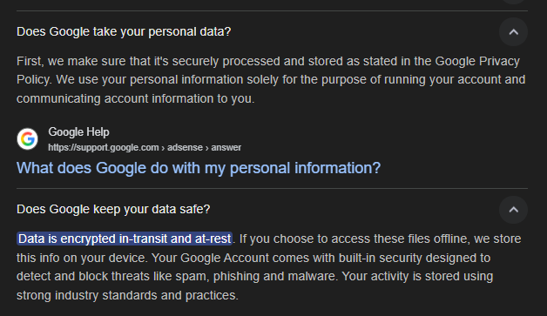

Slide 8
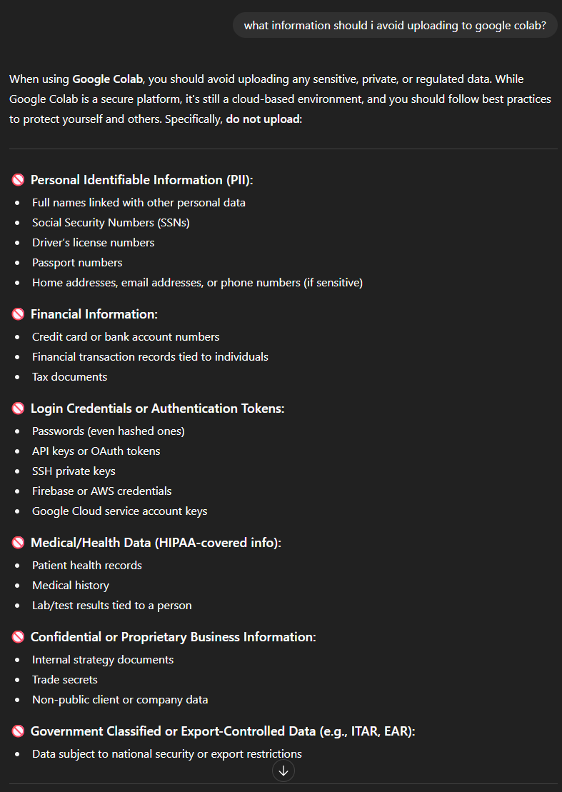
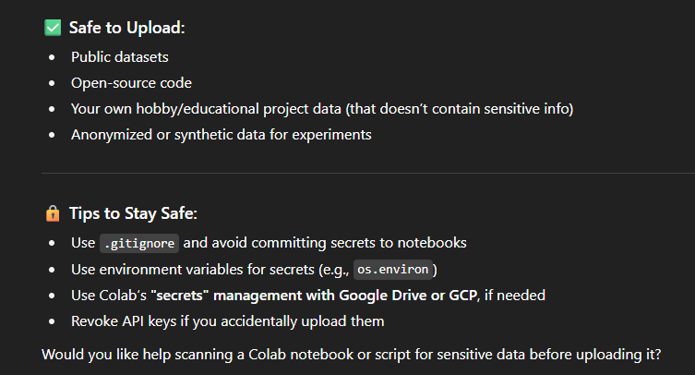
ChatGPT
Law Enforcement Specific
Avoid Victim/Suspect/Officer Information
Use data that would be on a public facing website
Get permission from Admin
Anonymize, if possible

Slide 9
DANGEROUS INTERSECTIONS
VERSATERM

Slide 10
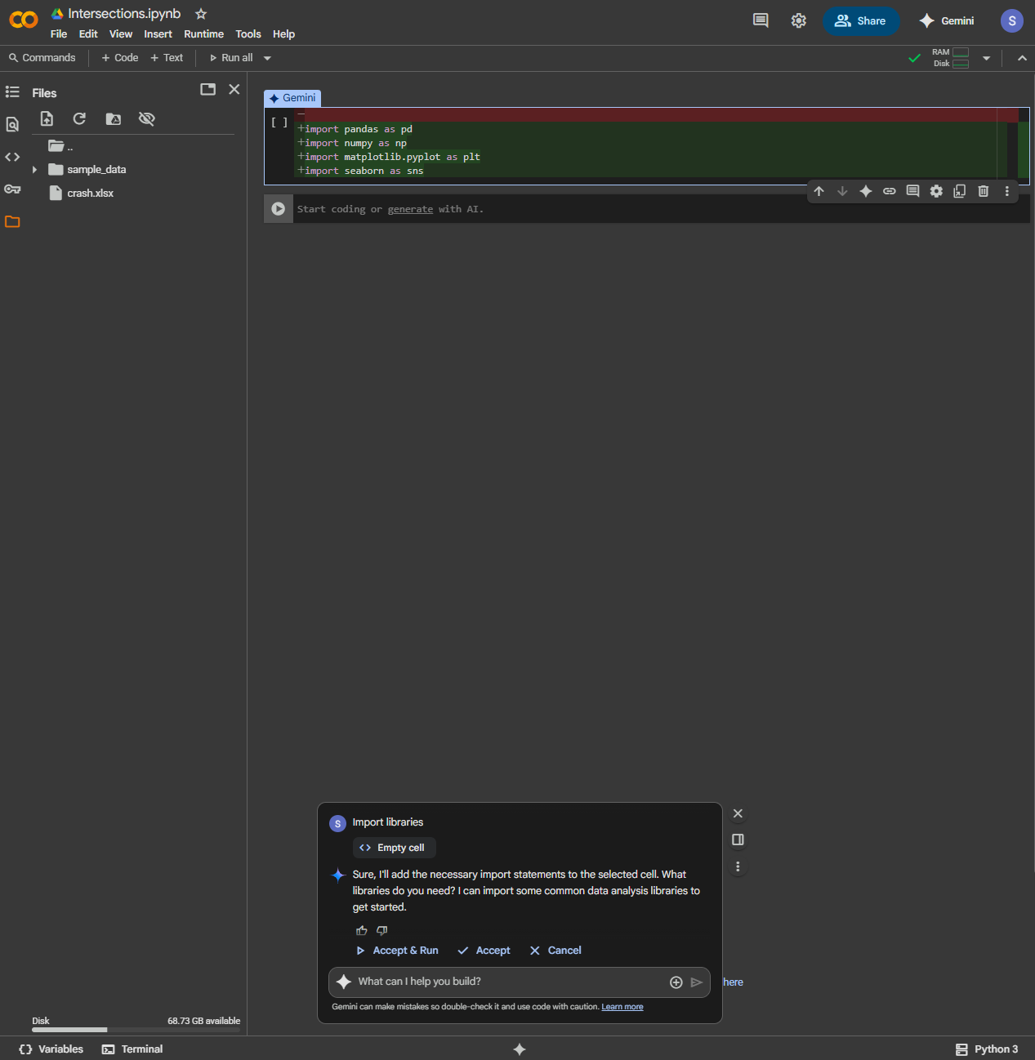
Drag and Drop File – crash.xlsx
(Excel, CSV, Text)
Rename Untitled Notebook
IMPORT LIBRARIES
pandas – data manipulation/analysis
numpy – numerical calculations
matplotlib.pyplot – graphs/charts
seaborn – graphs/charts
plotly.express – graphs/charts

Slide 11
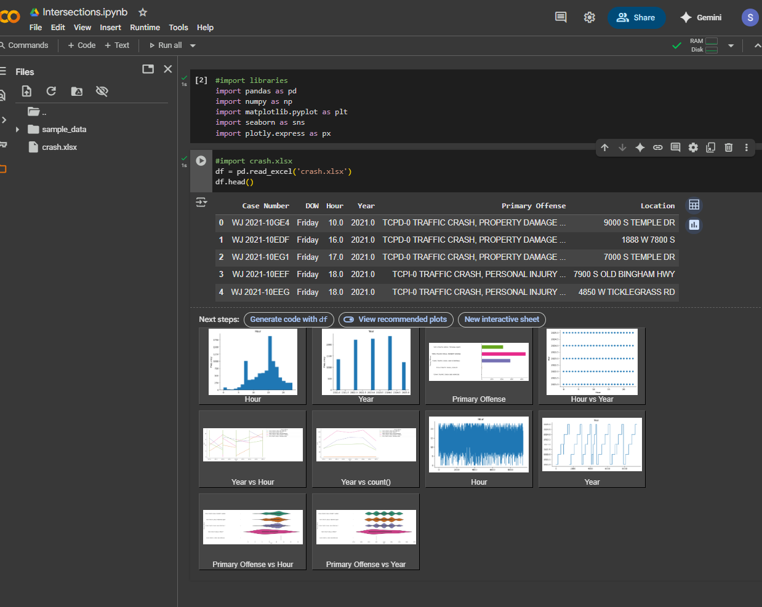
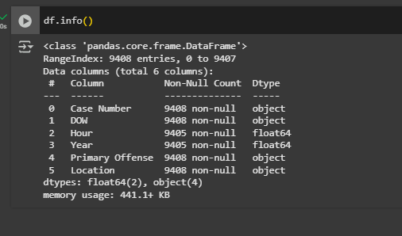
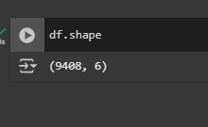
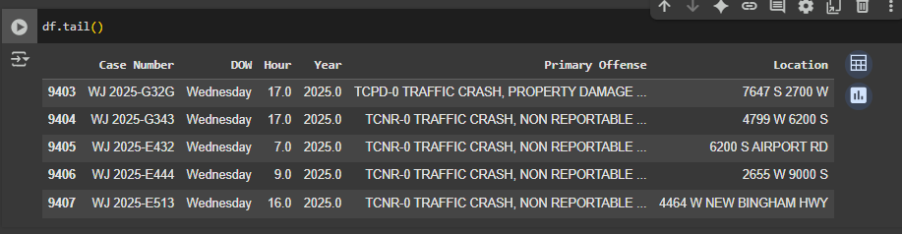
Import Excel file, df.head(), df.tail(), df.shape, df.info()
Column Format Category
First five rows
Rows, Columns
Object = Text
Float64 = Decimal Number
Int64 = Whole Number
Datetime64 = Date/Time
Last five rows

Slide 12
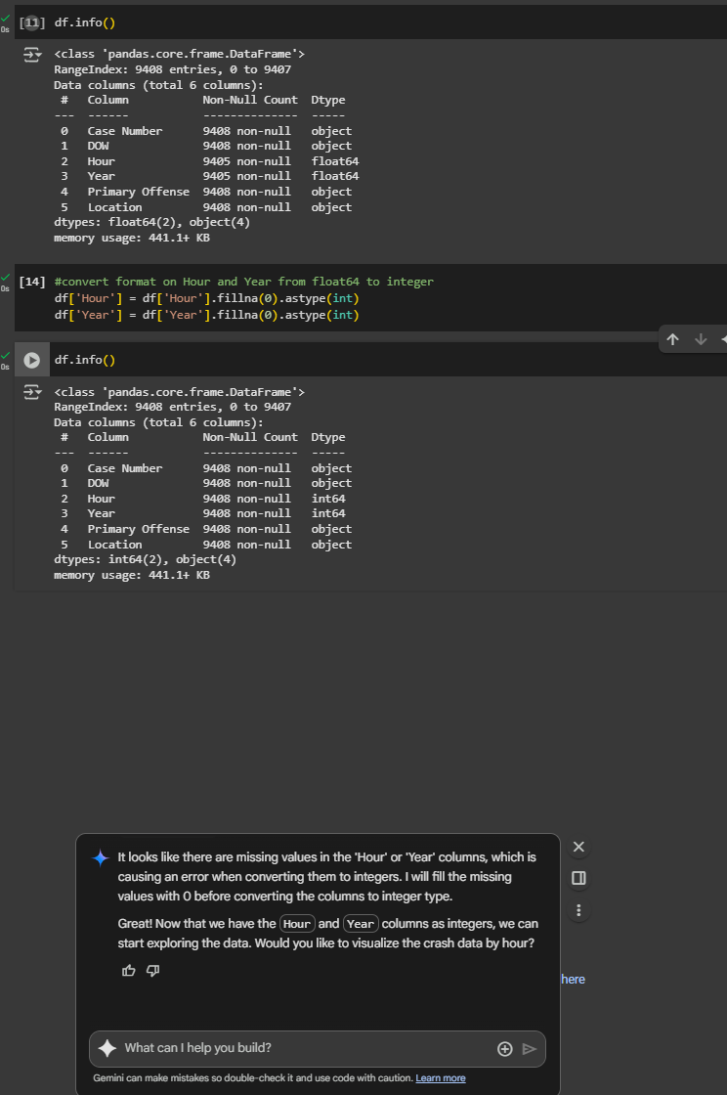
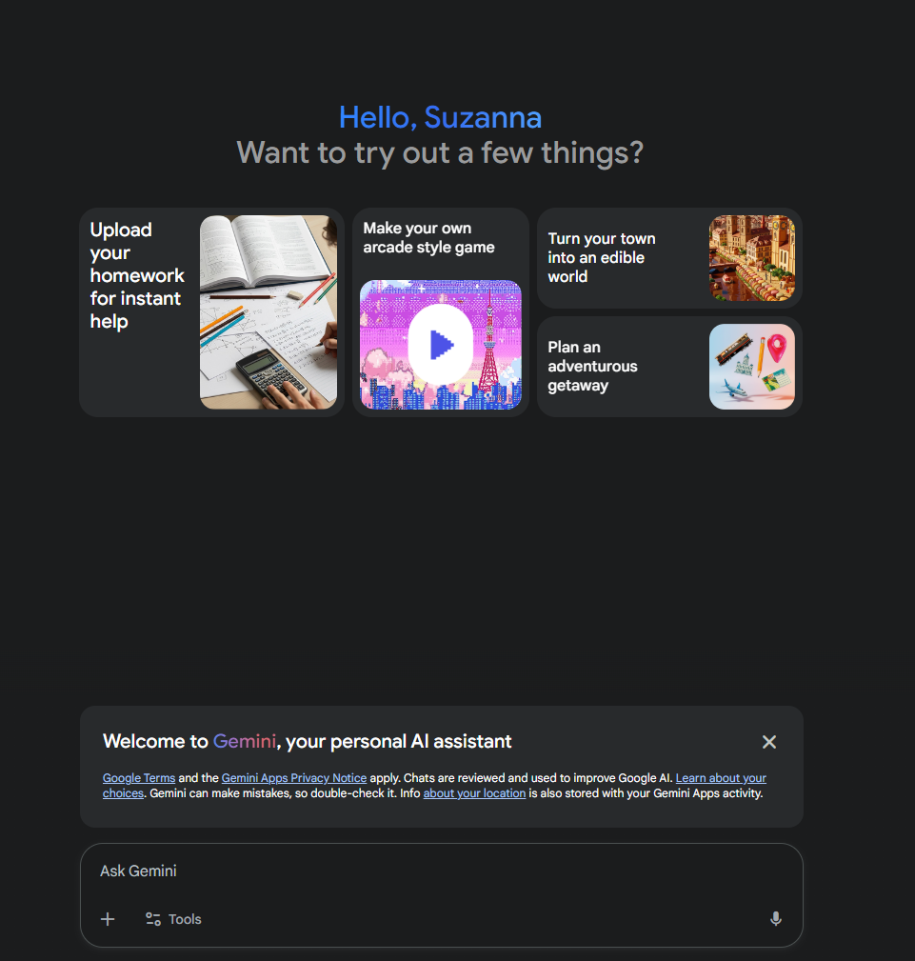
Convert Hour and Year to Integer
GEMINI: Convert Hour and Year to an Integer

Slide 13
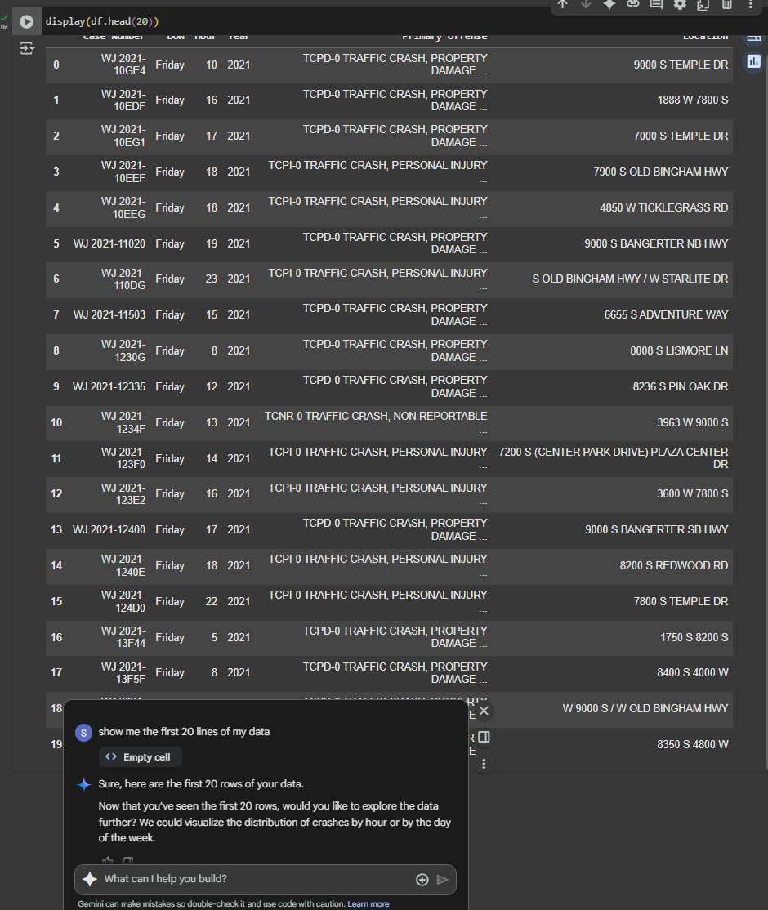
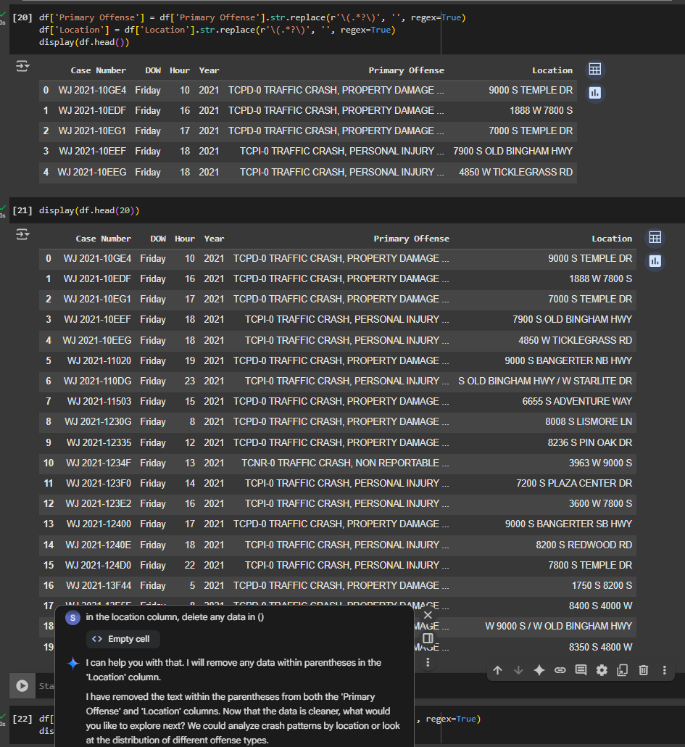
Show me the first 20 lines of my data
Delete data in parenthesis
GEMINI: 1. show me the first 20 lines of my data
2. In the location column, delete any data in ()

Slide 14
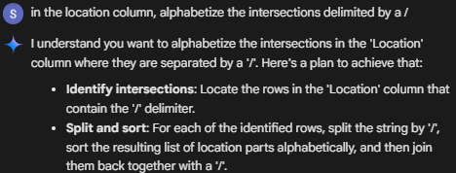
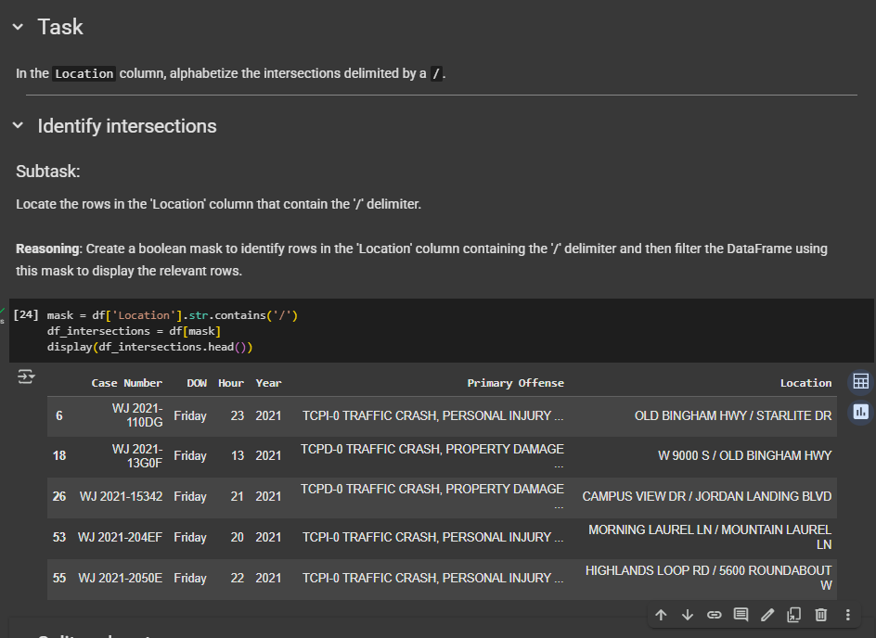

Alphabetize the intersections delimited by “/”
GEMINI: in the location column, alphabetize the intersections delimited by a /

Slide 15
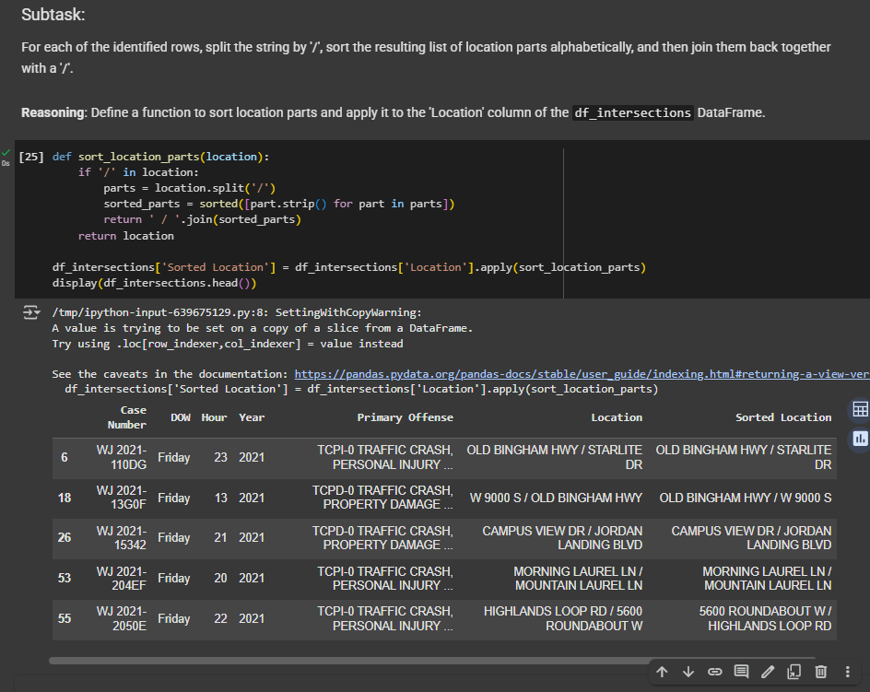
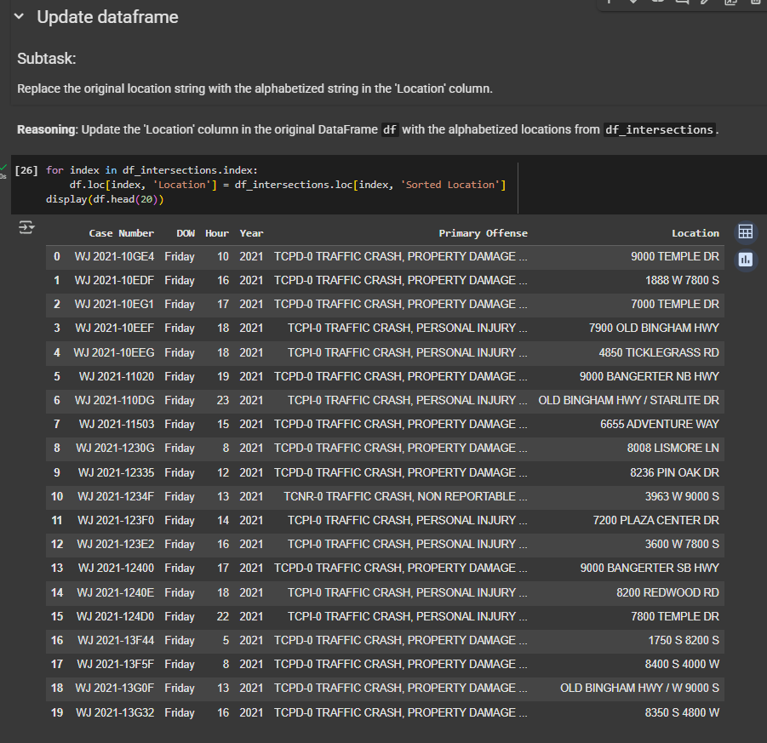
Alphabetize the intersections delimited by “/”

Slide 16
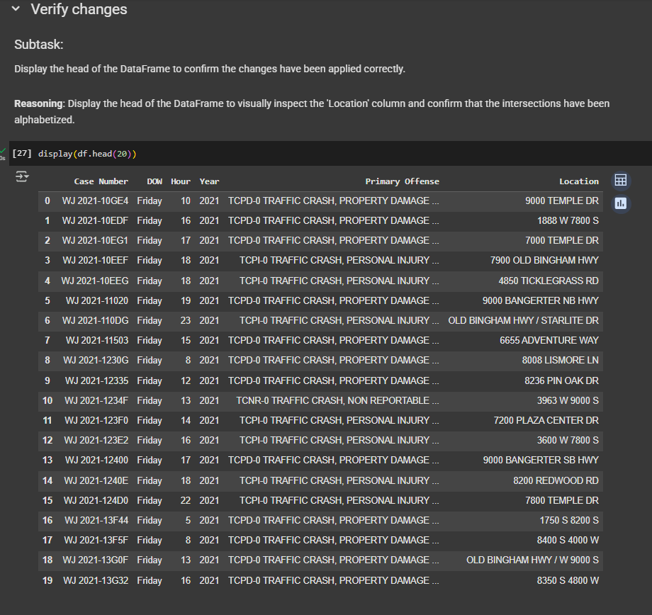
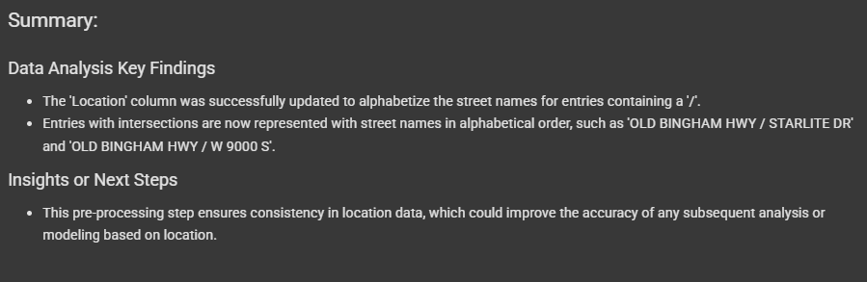
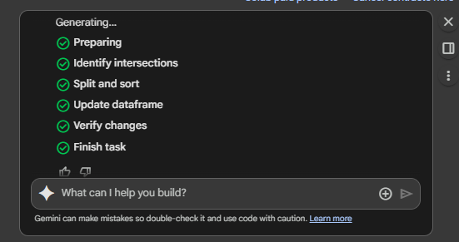
Alphabetize the intersections delimited by “/”

Slide 17
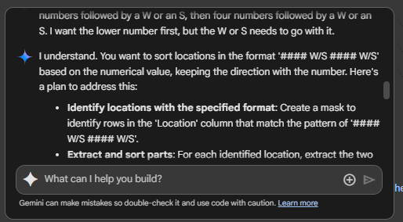
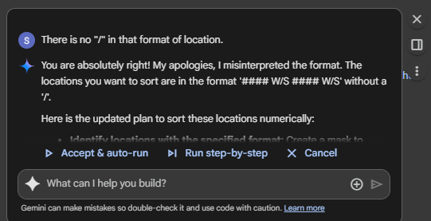
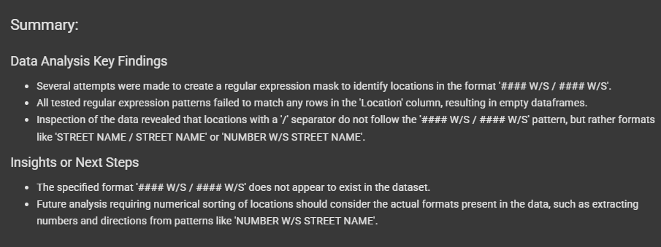
Reorder the numeric streets (ex. 8400 S 4000 W)
Took three tries to tell Gemini there was no “/” in this location format but it finally worked.
GEMINI: I would like to do the same with the locations that are formatted with four numbers followed by a W or an S, then four numbers followed by a W or an S. I want the lower number first, but the W or S needs to go with it.

Slide 18
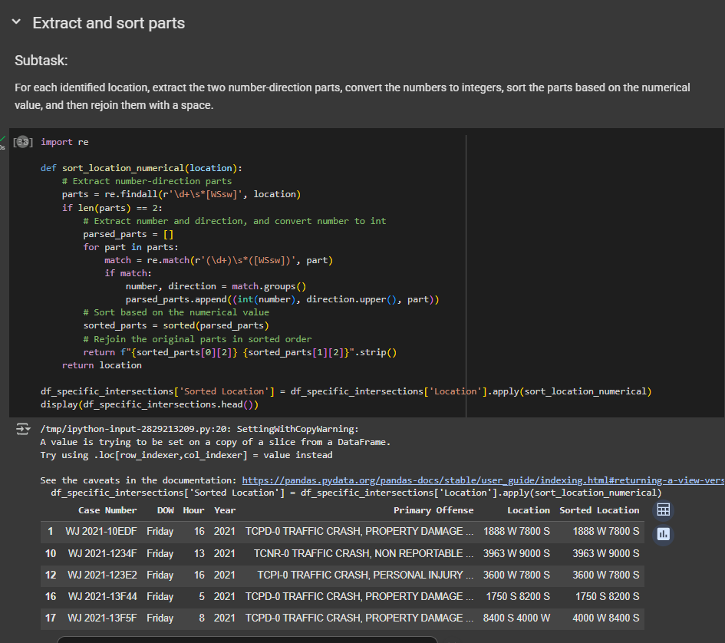
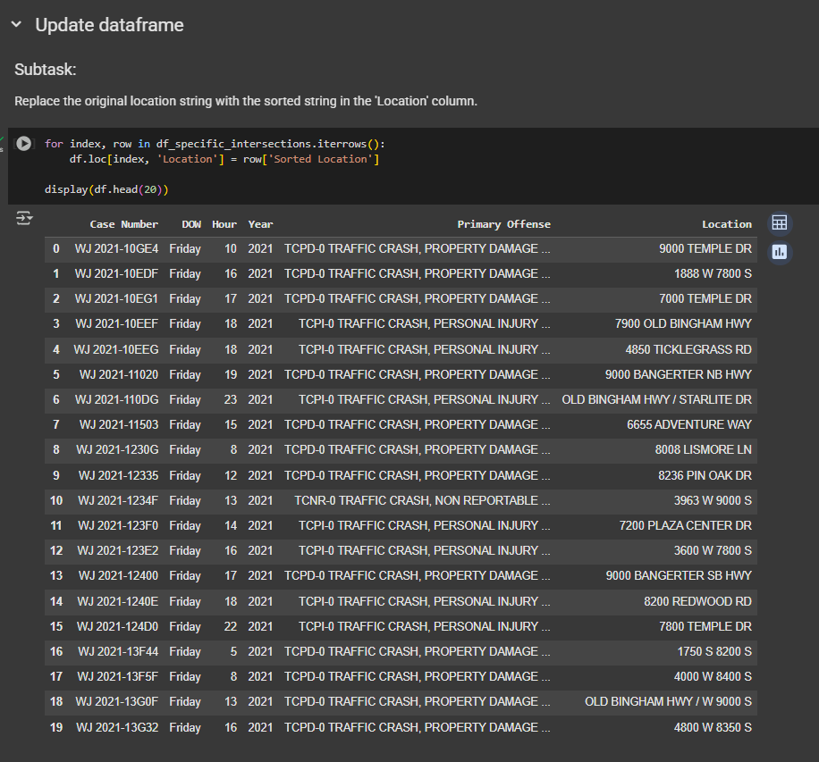
Reorder the numeric streets (ex. 8400 S 4000 W)

Slide 19
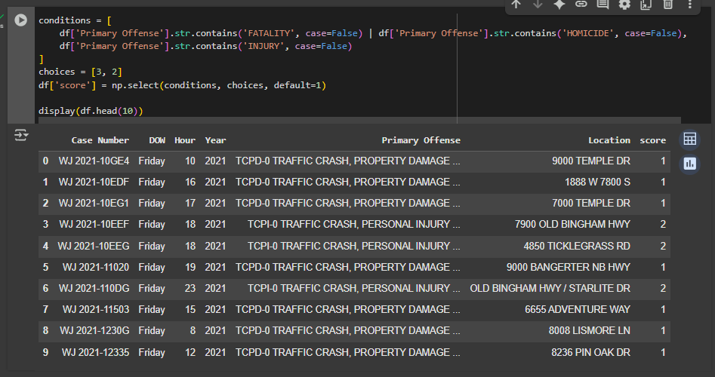
Add a new column called Score, values based on Primary Offense
GEMINI: Insert a new column called score - base the value on the Primary Offense column. If Primary Offense contains "FATALITY" OR "HOMICIDE", put a 3 in the score column. If the Primary Offense column contains "INJURY", put a 2 in the score column, else 1.

Slide 20
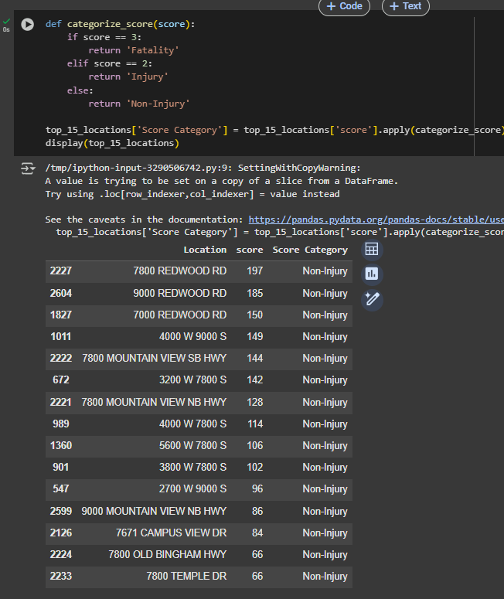
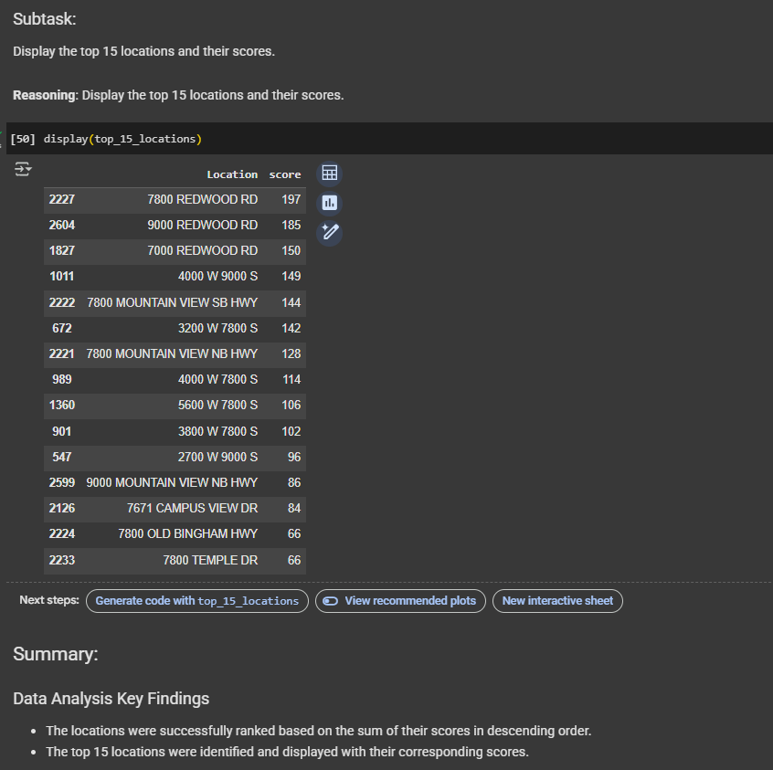
df['Location'] = df['Location'].str.replace('1700 W', 'REDWOOD RD') display(df.head(20))
Top Location
GEMINI: Display the top 15 locations, grouped by score (if 3 call it Fatality, if 2 call it Injury, if 1 call it Non-Injury)
GEMINI: Based on the score column, rank the top 15 locations descending

Slide 21
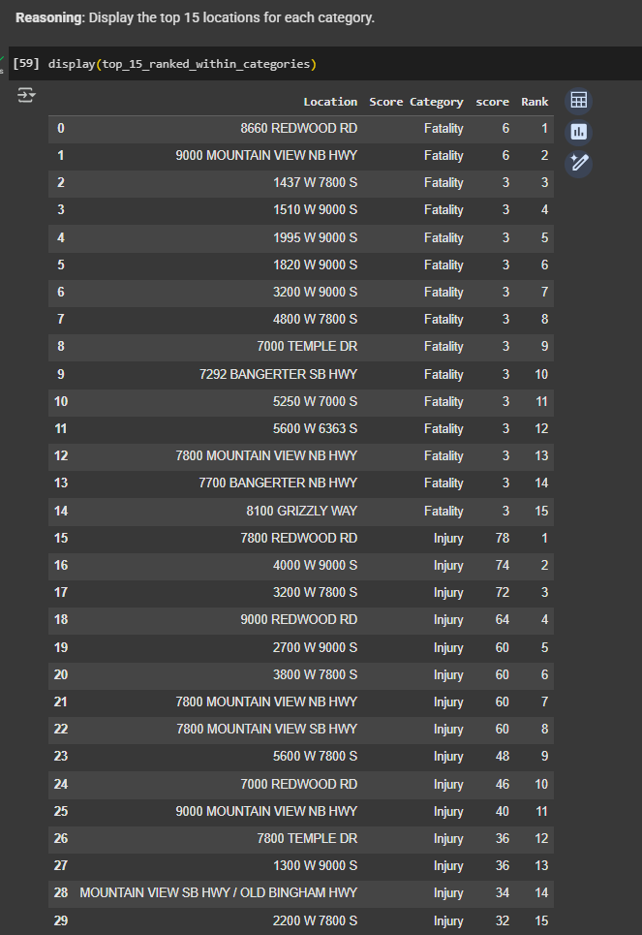
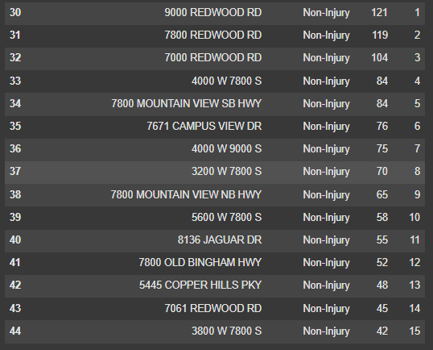
df['Location'] = df['Location'].str.replace('1700 W', 'REDWOOD RD') display(df.head(20))
Top Location
G: Would you like to see the distribution of the individual crash scores (Fatality, Injury, Non-Injury) within these top 15 locations, or would you like to categorize the scores in the original df DataFrame before calculating the total score for each location?
S: Yes, top 15 within these categories
G: Okay, I understand you want to see the top locations within each category (Fatality, Injury, and Non-Injury). Here's a plan to achieve that:
Categorize scores: Create a new column in the original DataFrame to categorize the scores as 'Fatality', 'Injury', or 'Non-Injury'.
Group by location and category: Group the DataFrame by both 'Location' and the new 'Score Category' column and calculate the sum of the scores for each group.
Rank within categories: For each 'Score Category', rank the locations based on their summed scores in descending order.
Select top 15 per category: Select the top 15 locations within each 'Score Category'.
Display results: Display the top 15 locations for each category.
Finish task: Summarize the findings for each category.

Slide 22
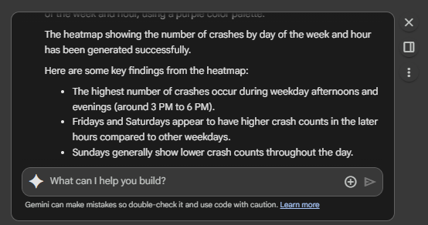
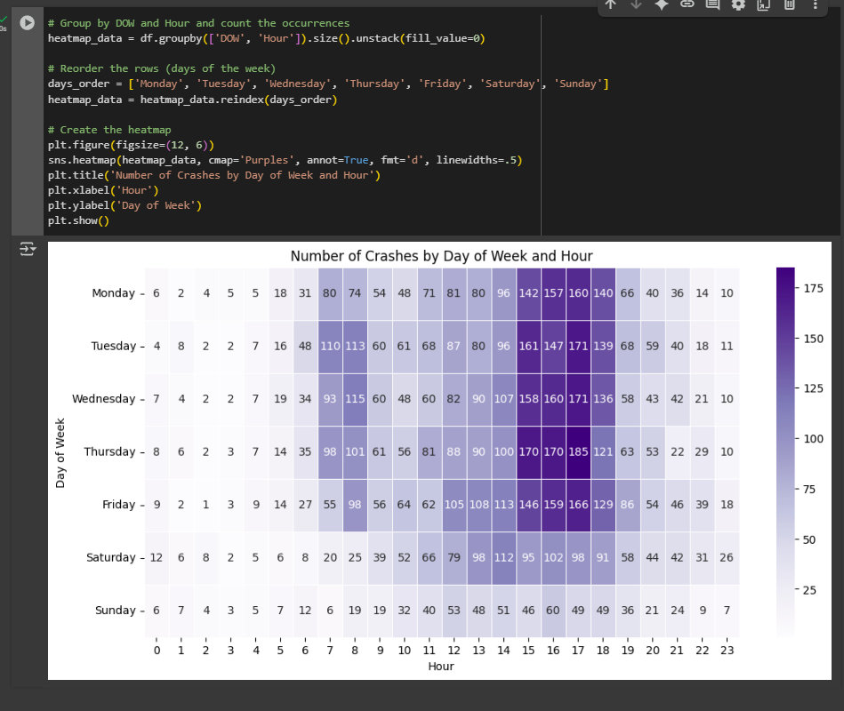
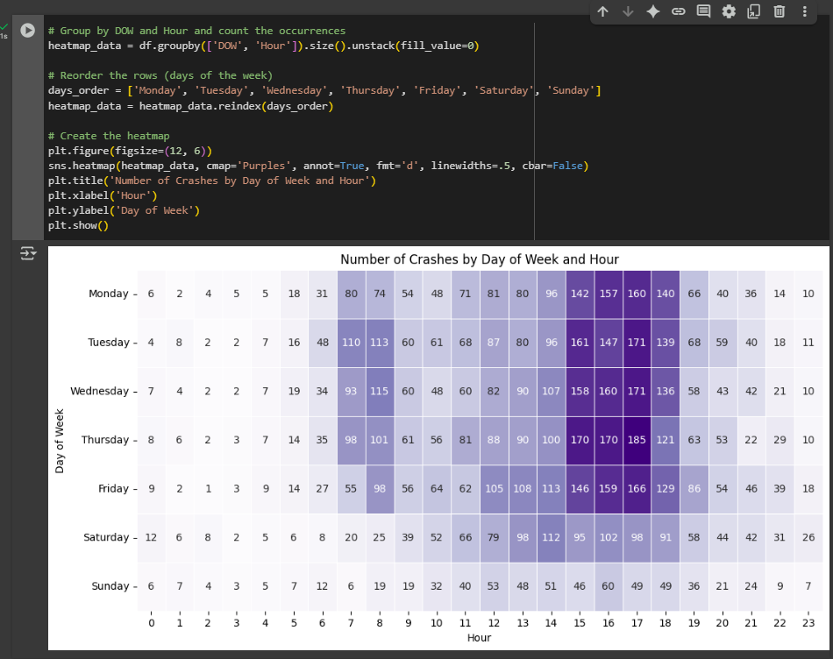
df['Location'] = df['Location'].str.replace('1700 W', 'REDWOOD RD') display(df.head(20))
Matrix
Add cbar = False to remove legend
GEMINI: on the total dataset, create a matrix with DOW in the rows and Hour in the columns, use purple.

Slide 23
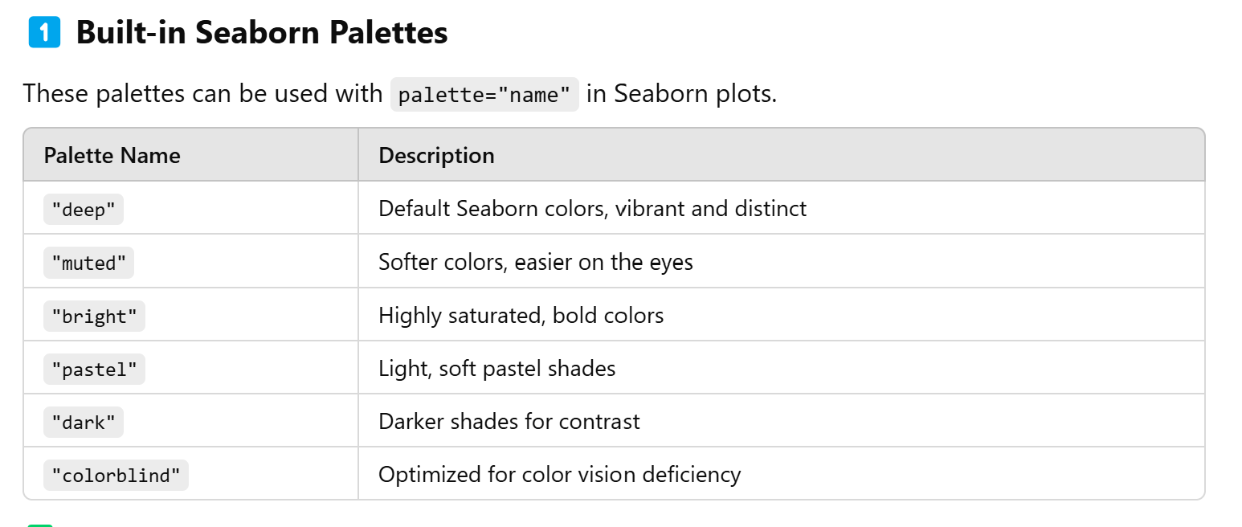
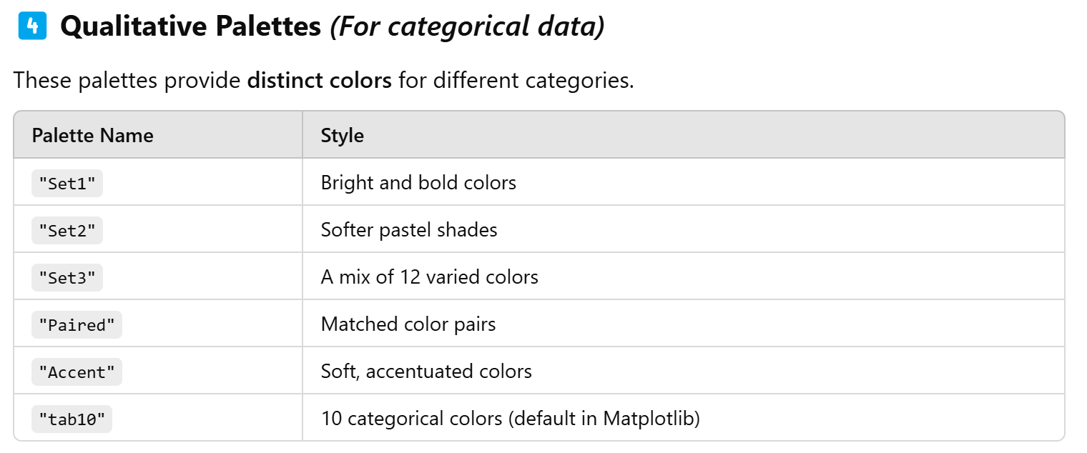
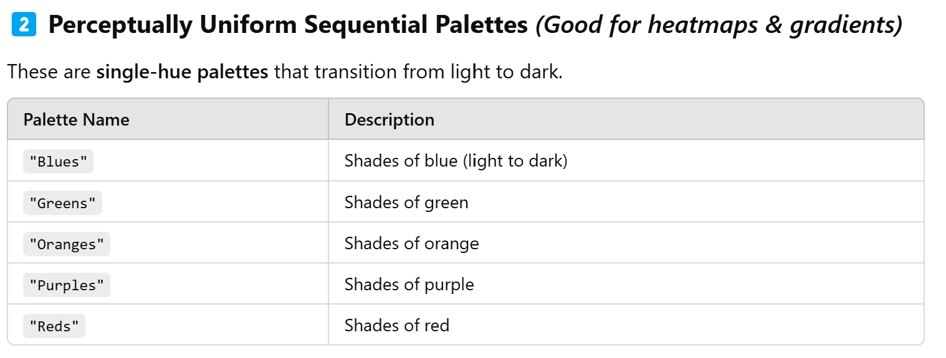
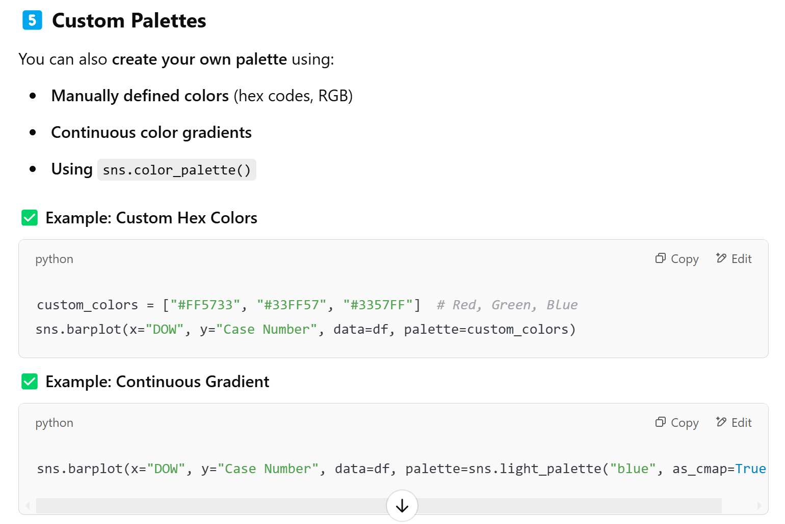
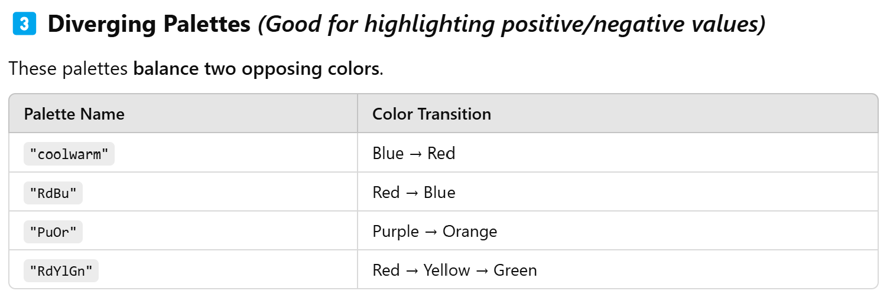

Slide 24
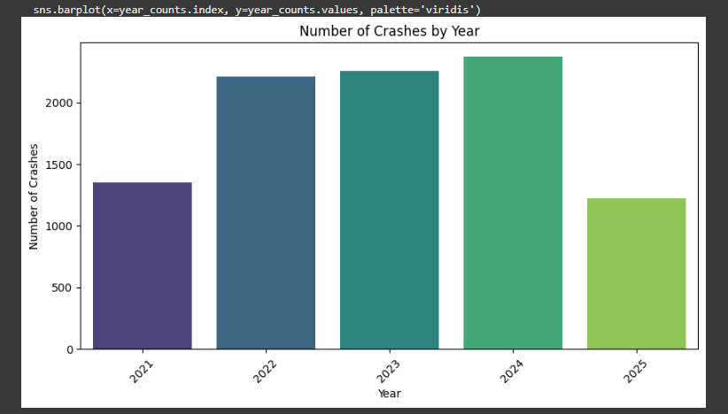
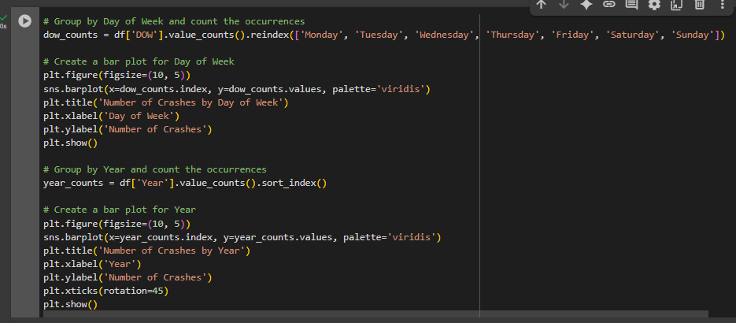
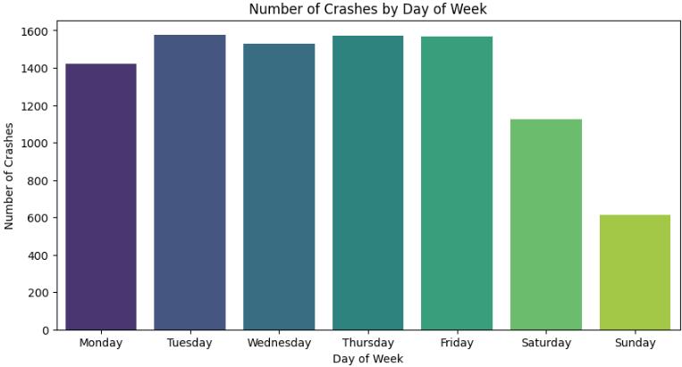
df['Location'] = df['Location'].str.replace('1700 W', 'REDWOOD RD') display(df.head(20))
Palette for a colorblind audience
Graphs
GEMINI: graphs for day of week and year

Slide 25
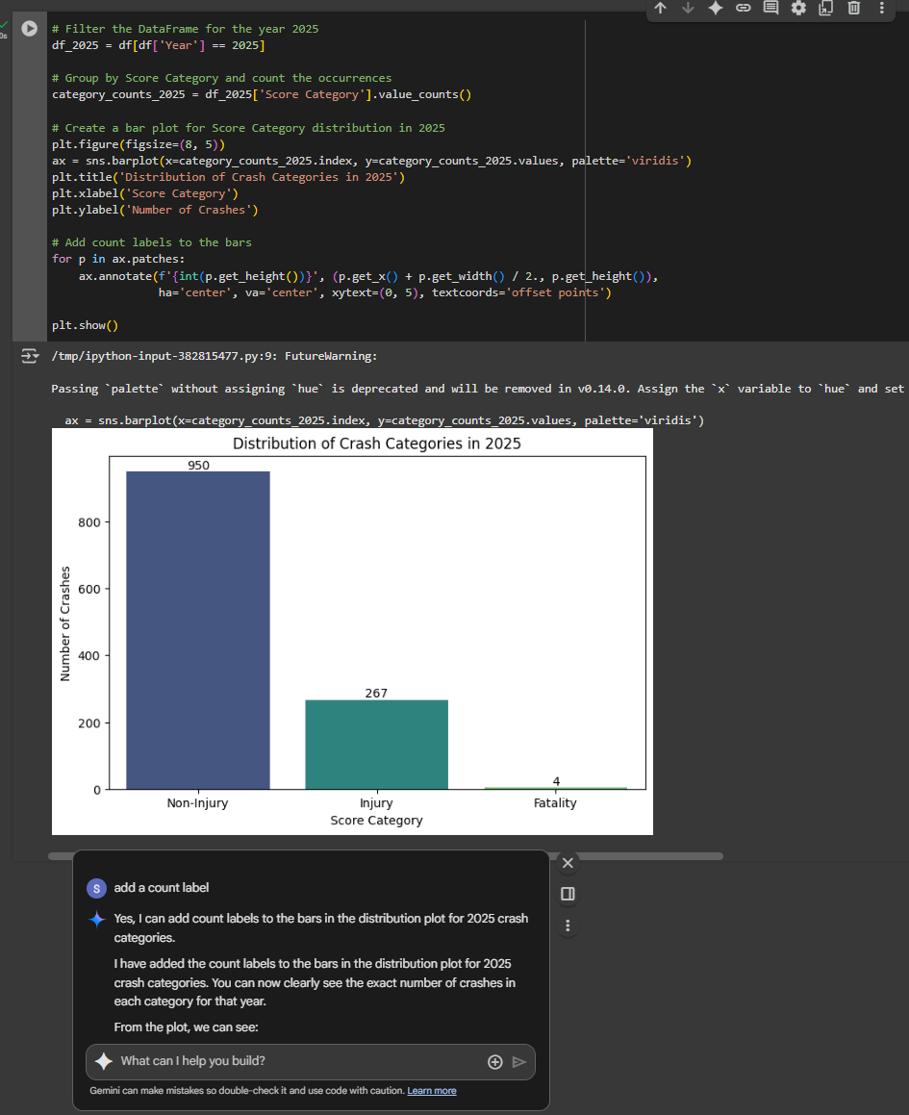
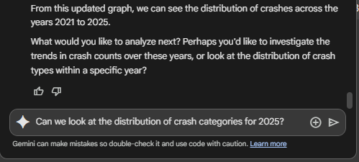
df['Location'] = df['Location'].str.replace('1700 W', 'REDWOOD RD') display(df.head(20))
Graphs
GEMINI: Can we look at the distribution of crash categories for 2025?
Add a count label.

Slide 26
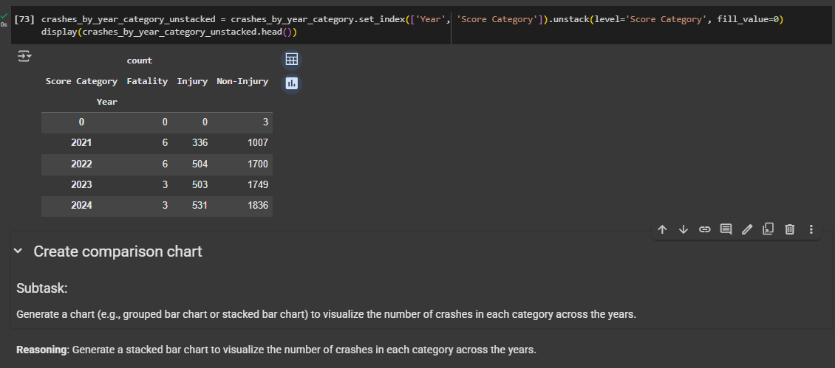
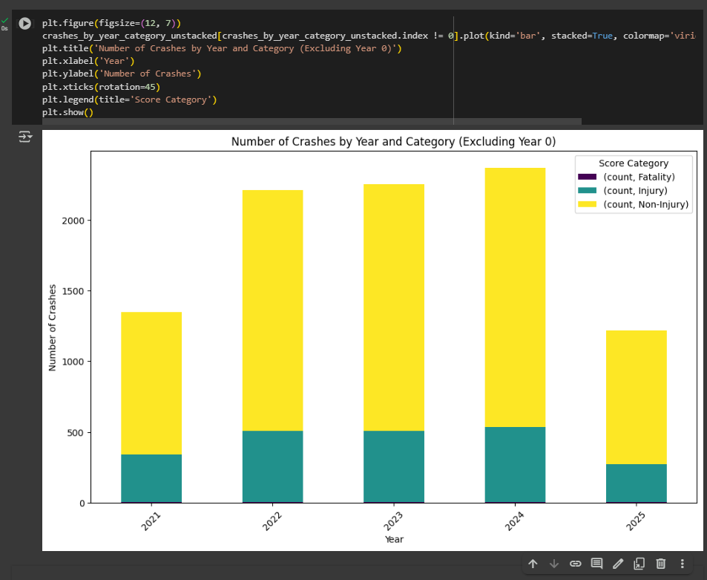
df['Location'] = df['Location'].str.replace('1700 W', 'REDWOOD RD') display(df.head(20))
Graphs
GEMINI: Comparison charts by category across the years

Slide 27



df['Location'] = df['Location'].str.replace('1700 W', 'REDWOOD RD') display(df.head(20))
Export and Download
GEMINI: Export final dataframe and all the graphs as jpgs

Slide 28
UNPIVOT
SPILLMAN

Slide 29



SPILLMAN
3.5 Years of Data
22+ text files per year
Challenges:
Export to text file
Data in Rows not Columns

Slide 30

ChatGPT
SPILLMAN
3.5 Years of Data
22+ text files per year
Data needed in Rows
Drag & Drop 22 files into Google Colab.

Slide 31

ChatGPT

Slide 32



Slide 34

THANK YOU
Suzanna Howard
Suzanna.howard@westjordan.Utah.gov
West Jordan Police Department

Slide 35
Creating efficiency with google Colab Hour two Suzanna Howard West Jordan (UT) police department
*Gmail account required to use Google Colab

Slide 37
Use Google Colab online to build Jupyter Notebooks.
Drag and drop an Excel file into Google Colab
Use AI-generated Python code to write the steps we would do in Excel (sort, insert columns, formulas, clean data, etc)
Export files
Save/download Jupyter Notebook for future use
In Excel terms, it is similar to macros.

Slide 38
HOUR ONE
https://github.com/Suzanna-Howard34/IACA-Lab-Files
INTRODUCTION TO GOOGLE COLAB
CAVEATS
Activities:
dangerous intersections
graphs/charts
unpivot
HOUR TWO
INTRODUCTION TO GOOGLE COLAB
CAVEATS
Activities:
officer AVAILABILITY
forecasting / EDUCATED GUESSING
graphs/charts

Slide 39
Google “Google Colab”
https://colab.research.google.com/
Type: Colab.new
GMAIL ACCOUNT REQUIRED
FREE ONLINE TOOL
NO INSTALLATION/CONFIGURATION
JUPYTER NOTEBOOKS
AI GENERATED PYTHON CODE
GEMINI
CHAT GPT
# COMMENT

Slide 42
ChatGPT
Law Enforcement Specific
Avoid Victim/Suspect/Officer Information
Use data that would be on a public facing website
Get permission from Admin
Anonymize, if possible

Slide 43
OFFICER AVAILABILITY
SPILLMAN / VERSATERM

Slide 44

Starter Steps
Rename Untitled Notebook
Click on Files, Drag and Drop file
Import Libraries
Import Excel file
df.head() – first 5 rows
Df.tail() – last 5 rows
df.shape – rows, columns
df.info() – format categories
Object = Text
Float64 = Decimal Number
Int64 = Whole Number
Datetime64 = Date/Time
Timedelta64[ns(1) = time

Slide 45

# Sort by Unit then Date/Time

Slide 46

# create a new column called Time that subtracts the current Date/Time from the previous Date/Time

Slide 47

# remove any rows that have a value in the Time column over 5:00:00

Slide 48

# create a new column called Date that includes only the date from the Date/Time column

Slide 49

# convert Date column to a Date format

Slide 50


Gemini: Filter on the Status column, only rows with ENRT if it follows a row with CMPLT

Slide 51



Gemini:
Create a new column called SUM, which sums the Time column, group by Unit and Date
Create a new column called AVG, which averages the Time column, group by Unit and Date
Create a new column called SumAVG, which averages the SUM column, group by Unit
Create a new column called AVGAvail, which averages the AVG column, group by Unit

Slide 52

# remove duplicate Units

Slide 53

# run descriptive statistics on AVGAvail

Slide 54


# export DFF and descriptive statistics of AVGAvail in Excel

Slide 55



LET’S RACE
Drag & drop CAD2019.xlsx
Rename import file to 2019
Rename export files to 2019
Start at the top and push the play button on each step in order. Can you beat my time?

Slide 56




Raw records to Descriptive Statistics – 45.43 seconds

Slide 57

Versaterm – 11 Times (each shift change)
Spillman – 4 Times

Slide 58
FORECASTING
eXCEL

Slide 59

NORTH1
NORTH3
NORTH5
NORTH2
NORTH4
NORTH6
SOUTH2
SOUTH4
SOUTH6
SOUTH1
SOUTH3
SOUTH5
WEST JORDAN ZONES

Slide 60


Import Libraries – Add Excel Files – Add Column Called Zone – Merge Files

Slide 61



Import New Merged Excel File, df.head(), df.tail()

Slide 62

Convert Date fields to Date Format

Slide 63


Insert columns for Day of Week and Hour (based on Report Date/Time)

Slide 64

Sort by Zone, Report Date/Time (Ascending)

Slide 65


Insert Days Between Hits (DBH) Calculation Column, group by Zone

Slide 66


First I asked Gemini to round to 4 decimal places, then I asked ChatGPT

Slide 67

Rounding Issues – Updated Code

Slide 68

Run Descriptive Statistics by Zone

Slide 69


Descriptive Statistics by Zone, Last Date, Mean+StDev, Forecast Date Columns, Today
ChatGPT

Slide 70


Educated Guessing
Narrowed down 32 square miles to five 2.5 mile zones in 37.89 seconds.

Slide 71
GRAPHS AND CHARTS
eXCEL

Slide 72



Temporal Matrix
ChatGPT

Slide 73


Temporal Matrix
ChatGPT

Slide 75

Bar Chart

Slide 76

Bar Chart

Slide 77


Bar Chart – Separated by Zone

Slide 78


Bar Chart – Separated by Zone, Export to JPG

Slide 79
THANK YOU
Suzanna Howard
Suzanna.howard@westjordan.Utah.gov
West Jordan Police Department

